Slide 1
CSCIU 210 Computer Organization AKM Jahangir A Majumder, PhD
Fall 2018 - Lecture 13
September 24, 2018
Note: Some slides are adapted from those used by previous instructors and some slides include figures from the textbook.

Slide 2
Review and Learning Outcomes
We will continue to cover Circuits and Number Systems
We will begin to cover how to do math in the binary format and how to implement it in hardware
The binary math we learn will be used to build arithmetic logic unit (ALU)
Quiz 2 grades and key are posted on Blackboard
Mean: 8.86
Median: 9.00
Standard Deviation: 1.52
Variance: 2.30
Grades and Key for Homework 2 are posted on Blackboard as well
We will have our Exam 1 on Friday, October 5, 2018

Slide 3
Where are we?
So far, we covered the following topics
Fundamental digital blocks: AND, OR, and NOT gates.
Boolean algebra.
Base conversion between different number bases.
We will begin to cover how to do math in the binary format and how to implement it in hardware.
The binary math we learn will be used to build arithmetic logic unit (ALU).

Slide 4
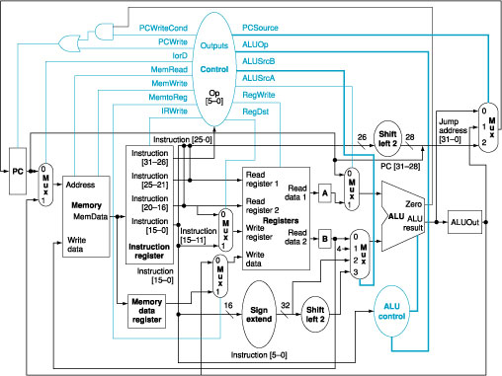
ALU in a MIPS Computer
ALU

Slide 5
Binary Addition with Pencil and Paper
1111
Carry In
Augend
1001
Addend
+)
1111
11000
Sum
1111
Carry Out

Slide 6
Functional Block: Half-Adder
A 2-input, 1-bit width binary adder that performs the following computations:
A half adder adds two bits to produce a two-bit sum
The sum is expressed as a sum bit , S
and a carry bit, C
The half adder can be specified
as a truth table for S and C ⇒
X
0
0
1
1
+ Y
+ 0
+ 1
+ 0
+ 1
C S
0 0
0 1
0 1
1 0
X
Y
C
S
0
0
0
0
0
1
0
1
Can you identify the logic expression
of C and S with X and Y as inputs?
1
0
0
1
1
1
1
0

Slide 7
Implementations: Half-Adder
The most common half adder implementation is:
S
=
X
⊕
Y
C
=
X
⋅
Y
X
S
Y
C

Slide 8
Functional Block: Full-Adder
A full adder is similar to a half adder, but includes a carry-in bit from lower stages. Like the half-adder, it computes a sum bit, S and a carry bit, C.
For a carry-in (Z) of 0, it is the same as the half-adder:
For a carry- in (Z) of 1:
Z
0
0
0
0
X
0
0
1
1
+ Y
+ 0
+ 1
+ 0
+ 1
C S
0
0
0 1
0 1
1 0
Z
1
1
1
1
X
0
0
1
1
+ Y
+ 0
+ 1
+ 0
+ 1
C S
0 1
1 0
1 0
1
1

Slide 9
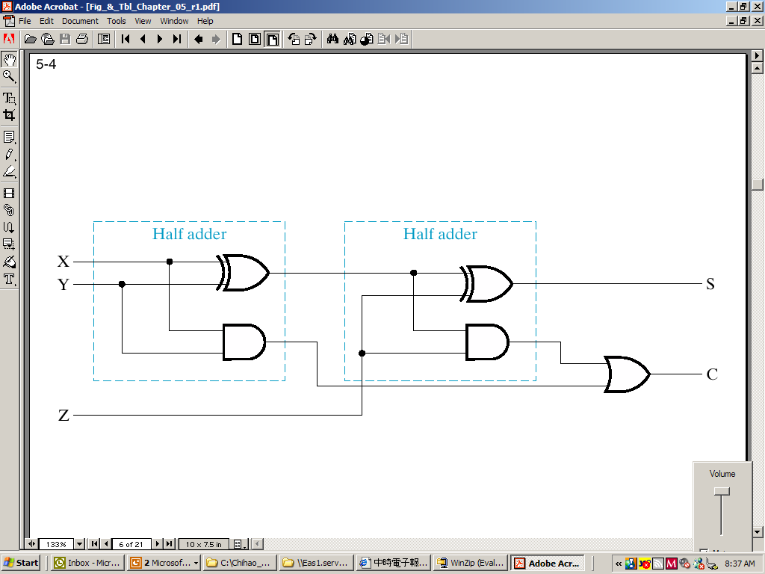
Implementation: Full Adder
Full Adder Schematic
S
=
X
⊕
Y
⊕
Z
C
=
X
Y
+
(
X
⊕
Y
)
Z

Slide 10
Binary Adders
To add multiple operands, we “bundle” logical signals together into vectors and use functional blocks that operate on the vectors
Example: 4-bit ripple carry adder: Adds input vectors A(3:0) and B(3:0) to get a sum vector S(3:0)
Note: carry out of cell i becomes carry in of cell i + 1
Description
Subscript
Name
3 2 1 0
Carry In
0 1 1 0
Ci
Augend
1 0 1 1
Ai
Addend
0 0 1 1
Bi
Sum
1 1 1 0
Si
Carry out
0 0 1 1
Ci+1

Slide 11
4-bit Ripple-Carry Binary Adder
A four-bit Ripple Carry Adder made from four 1-bit Full Adders is shown below.
One problem with the addition of binary numbers is the length of time to propagate the ripple carry from the least significant bit to the most significant bit. (Solution: look ahead adder.)

Slide 12
In-Class Exercise
Perform the following binary addition:
0011+1001
1110+0011

Slide 13
Sign Integer
In elementary school math, we use “+” to indicate a positive number, and “-” to indicate a negative number.
Since the computer can only identify 0 and 1, we use 0 and 1 to indicate positive and negative numbers.

Slide 14
Signed and Unsigned Integers
Three possible representations might be applied:
Signed Magnitude: Use 1 bit to present the sign of number (0: positive, 1: negative).
One’s Compliment: For n-bit number, use (2^{n}-1-K) to represent number -K
Two’s Compliment: For n-bit number, use (2^{n}-K) to represent number -K

Slide 15
Possible Representations
Assume that three bits are used to present signed integer. The followings are the signed integer presented by three signed integer systems.
Sign Magnitude One's Complement Two's Complement 000 = +0 000 = +0 000 = +0 001 = +1 001 = +1 001 = +1 010 = +2 010 = +2 010 = +2 011 = +3 011 = +3 011 = +3 100 = -0 100 = -3 100 = -4 101 = -1 101 = -2 101 = -3 110 = -2 110 = -1 110 = -2 111 = -3 111 = -0 111 = -1
Which one is best? Why?

Slide 16
Representation Range of n-bit Signed Integer (2’s Complement)
For a n-bit signed integer represented with 2’s complement, its range is −2^{n-1}~2^{n-1}−1
Note: for −2^{n-1}, its 2’s complement binary representation is
10 ⋅⋅⋅ 00₂
N-1 of zeros
If you take two’s complement of this number
you will get the same sequences!

Slide 17
Signed Integer in MIPS
32 bit signed numbers: 0000 0000 0000 0000 0000 0000 0000 0000_{two} = 0_{ten} 0000 0000 0000 0000 0000 0000 0000 0001_{two} = + 1_{ten} 0000 0000 0000 0000 0000 0000 0000 0010_{two} = + 2_{ten} ... 0111 1111 1111 1111 1111 1111 1111 1110_{two} = + 2,147,483,646_{ten} 0111 1111 1111 1111 1111 1111 1111 1111_{two} = + 2,147,483,647_{ten} 1000 0000 0000 0000 0000 0000 0000 0000_{two} = – 2,147,483,648_{ten} 1000 0000 0000 0000 0000 0000 0000 0001_{two} = – 2,147,483,647_{ten} 1000 0000 0000 0000 0000 0000 0000 0010_{two} = – 2,147,483,646_{ten} ... 1111 1111 1111 1111 1111 1111 1111 1101_{two} = – 3_{ten} 1111 1111 1111 1111 1111 1111 1111 1110_{two} = – 2_{ten} 1111 1111 1111 1111 1111 1111 1111 1111_{two} = – 1_{ten}
maxint
minint

Slide 18
2’s Complement Representation
For a positive number: “0” is added in the beginning of the number
115₁₀=01110011₂
For a negative number:
115₁₀ = 01110011₂, we use 8 bits to present a number, then we have:
(2⁸ ) = 256₁₀ or 100000000₂
The 2's complement of 01110011 is then:
100000000₂ -) 01110011₂ 10001101₂
The alternative method: invert all bits and add 1.

